Slide 1
Review: fork() system call
The entire virtual address space of the parent is replicated in the child
At the time of fork() both memory spaces have the same content.
The child process and the parent process run in separate memory spaces.
The child inherits copies of the parent's set of open file descriptors.
Each file descriptor in the child refers to the same open file description (see open(2)) as the corresponding file descriptor in the parent.
This means that the two file descriptors share open file status flags, file offset, and signal-driven I/O attributes

Slide 2
Review: fork() system call
On success,
returns PID of the child process in the parent,
returns 0 in the child.
On failure,
-1 is returned in the parent,
no child process is created,
and errno is set appropriately.
EAGAIN A system-imposed limit on the number of threads was encountered. There are a number of limits that may trigger this error:
the kernel's system-wide limit on the number of processes and threads, /proc/sys/kernel/threads-max, was reached
the maximum number of PIDs, /proc/sys/kernel/pid_max, was reached
For more see $man -S2 fork

Slide 3
Fork and file descriptors
File descriptors are copied in fork!
/*we have two file descriptors*/
if(!fork()) {
int file = open(...);
read(file, ...);
} else {
int file = open(...);
read(file, ...);
}
/* one process reads one part the other reads another part */
int file = open(...);
if(!fork()) {
read(file, ...);
} else {
read(file, ...);
}

Slide 4
Review: wait() system calls
#include <sys/wait.h>
int WIFEXITED (status);
int WIFSIGNALED (status);
int WIFSTOPPED (status);
int WIFCONTINUED (status);
int WEXITSTATUS (status);
int WTERMSIG (status);
int WSTOPSIG (status);
int WCOREDUMP (status);
#include <sys/types.h>
#include <sys/wait.h>
pid_t wait(int *status);
pid_t waitpid(pid_t pid, int *status, int options);
/*example use*/
wait(&status);
waitpid(-1, &status, 0);
/*more precise control: siginfo_t is a structure with pid, uid,status etc*/
int waitid(idtype_t idtype, id_t id,
siginfo_t *infop, int options);
See $man -S2 wait

Slide 5
int main() {
pid_t cpid = fork();
if(cpid > 0){
printf("parent id: %d, child id = %d.\n", getpid(), cpid);
/*in terminal $ps aux |grep "defunct"
see the ZOMBIE process*/
getchar();/*wait for user input*/
pid_t w = wait(NULL);
if (w == -1){
perror("wait:"); exit(EXIT_FAILURE);
}else{
printf("parent id: %d, ZOMBIE child id = %d.\n",
getpid(), w);
exit(EXIT_SUCCESS);
}
}else if(cpid == -1){
perror("fork:");
exit(EXIT_FAILURE);
}
}
/*zombie process example
*/
#include <unistd.h>
#include <stdio.h>
#include <stdlib.h>
#include <sys/wait.h>

Slide 6
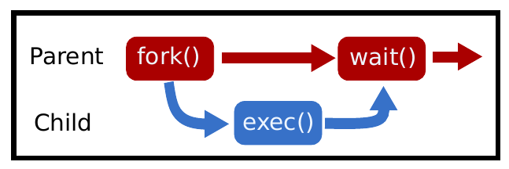
fork-exec-wait
#include <sys/types.h>
#include <sys/wait.h>
#include <unistd.h>
#include <stdio.h>
#include <stdlib.h>
int main() {
pid_t pid = fork();
if (pid < 0) {/* fork failure*/
exit(1);
} else if (pid > 0) {
waitpid(pid, NULL, 0);
} else {
execl("/bin/ls", "/bin/ls", NULL);
exit(1); /*For safety.*/
}
}

Slide 7
Environment variables
Environment variables are variables that the system keeps for all processes to use.
Your system has these set up right now! In Bash, some are already defined
$ echo $HOME
$ echo $PATH
Environment variables are important because they are inherited between processes and can be used to specify a standard set of behaviors

Slide 8
In C;
#include <stdlib.h>
char* getenv (const char *name)
int setenv (const char *name, const char *value, int overwrite)
int putenv (const char *string)
void unsetenv (const char *name)
$ echo $HOME
$ echo $PATH
/*example use*/
char* home = getenv("HOME");
setenv("HOME", "/home/adaskin", 1);
Environment variables are important because they are inherited between processes and can be used to specify a standard set of behaviors

Slide 9
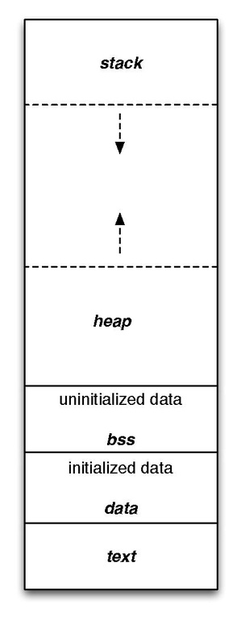
Basic
Memory Allocators
Memory allocation/deallocation is done by almost any application
The heap at the system level is contiguous series of addresses that the program can expand or contract
In LINUX, this is called the program break.
brk() and sbrk() change the location of the program break

Slide 10
C memory allocation API
#include <stdlib.h>
/*Allocate SIZE bytes of memory.uninitialized!*/
void *malloc(size_t size);
int *ptr;
ptr = (int*) malloc (sizeof(int));
if(ptr == NULL) abort();
memset(ptr, 0, sizeof(struct foo));

Slide 11
examples
struct foo *ptr;
ptr = (struct foo *) malloc (sizeof(struct foo));
if(ptr == 0) abort();
memset(ptr, 0, sizeof(struct foo));
int *ptr[10]; /*10 pointers for integer-addresses*/
ptr[0] = (int *) malloc(sizeof(int);
ptr[1] = (int *) malloc(sizeof(int);
int **ptr; /* a pointer to for the address of apointer*/
ptr = (int **)malloc(sizeof(int*));

Slide 12
C memory allocation API
/* Allocate NMEMB elements of SIZE bytes each,
all initialized to 0.*/
void *calloc(size_t nmemb, size_t size);
int *ptr;
ptr = (int*) calloc(1000, sizeof(int));
if(ptr == NULL){
perror("calloc:");
exit(EXIT_FAILURE);
}

Slide 13
A simple Implementation of calloc()
void *calloc(size_t count, size_t eltsize){
size_t size = count * eltsize;
void *value = malloc(size);
if (value != 0)
memset(value, 0, size);
return value;
}

Slide 14
Changing the size of the allocated memory
void *xrealloc(void *ptr, size_t size){
void *value = realloc(ptr, size);
if (value == 0)
perror("Virtual memory exhausted");
return value;
}

Slide 15
free()
Usually, allows a later call to malloc to reuse the space.
In the meantime, the space remains in your program as part of a free-list used internally by malloc.
Occasionally, free can actually return memory to the operating system and make the process smaller.
Any use of a pointer that refers to freed space results in undefined behavior.
int *ptr = malloc(sizeof(*ptr));
do_something(ptr);
free(ptr);

Slide 16
free()
Freeing a block alters the contents of the block. Copy whatever you need out of the block before freeing it!
struct chain{
struct chain *next;
char *name;
};
void free_chain(struct chain *chain){
while (chain != 0) {
struct chain *next = chain->next;
free(chain->name);
free(chain);
chain = next;
}
}

Slide 17
realloc(): changes the size of the memory block to newsize bytes.
void * realloc(void * ptr, size_t newsize) {
/*Simple implementation always reserves more memory and has no error checking*/
void *result = malloc(newsize);
size_t oldsize = ... /*(depends on allocator’s internal data*/
if (ptr){
memcpy(result, ptr, newsize < oldsize ? newsize : oldsize);
}
free(ptr);
return result;
}

Slide 18
If realloc fails then the program leaks memory.
void * realloc(void * ptr, size_t newsize) {
/*Simple implementation always reserves more memory and has no error checking*/
void *result = malloc(newsize);
size_t oldsize = ... /*(depends on allocator’s internal data*/
if (ptr){
memcpy(result, ptr, newsize < oldsize ? newsize : oldsize);
}
free(ptr);
return result;
}
int main() {
/* 1 */
int *array = malloc(sizeof(int) * 2);
array[0] = 10; array[1] = 20;
/* Oops need a bigger array -
so use realloc..*/
array = realloc(array, 3 * sizeof(int));
array[2] = 30;
}

Slide 19
Memory leaks
More robust version
int main() {
int *array = malloc(sizeof(int) * 2);
array[0] = 10; array[1] = 20;
void *tmp = realloc(array, 3 * sizeof(int));
if (tmp == NULL) { /*Nothing to do here.*/
}else if (tmp == array) {/*realloc returned same space*/
array[2] = 30;
}else {/* realloc returned different space */
array = tmp;
array[2] = 30;
}
}

Slide 20
Heap and sbrk() system call
The heap is part of the process memory and varies in size.
Heap memory allocation is performed by the C library when a program calls malloc ( calloc , realloc ) and free .
By calling sbrk() the C library can increase the size of the heap as your program demands more heap memory.
Modern operating system memory allocators no longer need sbrk.
Instead, they can request independent regions of virtual memory and maintain multiple memory regions (mmap).
Sbrk may be used for small memory requests

Slide 21
Changing the location of the program break
<unistd.h>
int brk (void *end_data_addr)
sets the end of the calling process’ data segment to end_data_addr.
void *sbrk (intptr_t increment);
Increases the current end by increment
sbrk(0) returns the current location of the program break
On error, errno is set to ENOMEM

Slide 22
Notes on sbrk
Program break: the end of the process's data segment (i.e., the program break is the first location after the end of the uninitialized data segment).
Programs don’t need to call brk or sbrk typically.
Instead programs use malloc , calloc , realloc and free which are part of the C library.
The internal implementation of these functions may call sbrk or other system calls (such as mmap) when additional heap memory is required.

Slide 23
void *top_of_heap = sbrk(0);
sbrk(1024);
malloc(16384);/implementation is different on different systems (virtual memory etc)*/
void *top_of_heap2 = sbrk(0);
printf("The top of heap went from %p to %p \n", top_of_heap,top_of_heap2);
The memory that was newly obtained by the operating system must be zeroed out (otherwise security leak).
But, later calls are not always zero.

Slide 24
char* ptr = malloc(300);
/*contents is probably zero because we get brand new memory so beginner programs appear to work!*/
//strcpy(ptr, "Some data"); /*work with the data*/
free(ptr);
/* later*/
char *ptr2 = malloc(300);
/*Contents might now contain existing data and is probably not zero*/

Slide 25
Implementing malloc() and free()
the simplest implementation of malloc
Ask the system for more bytes by extending the heap space.
sbrk returns -1 on failure

Slide 26
Drawbacks:
System calls are slow compared to library calls.
We should reserve a large amount of memory and only occasionally ask for more from the system.
No reuse of freed memory.
Our program never re-uses heap memory - it keeps asking for a bigger heap.
void *malloc(size_t size){
void *p = sbrk(size);
if (p == (void *)-1) /* No space left*/
return NULL;
return p;
}
void free(){ /* Do nothing */
}

Slide 27
Reusing a memory
During program execution, memory is allocated and deallocated
so there will be a gap in the heap memory that can be re-used for future memory requests.
The memory allocator needs to keep track of which parts of the heap are currently allocated and which are parts are available.
Free space management
How to implement?
An array, list?
How to keep track of free/not-free?
Placement strategy?

Slide 28
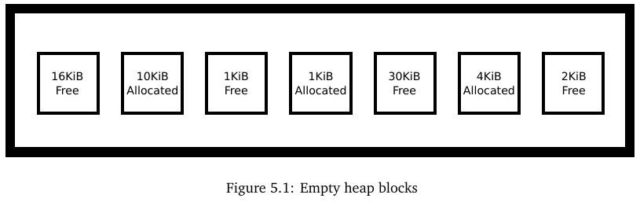
Placement Strategies
malloc(2048)
where should malloc reserve the memory?
First fit strategy
Next fit
Best fit
Worst fit

Slide 29
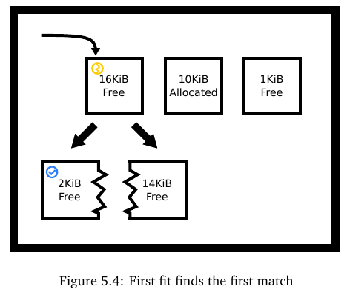
Placement Strategies
A first-fit strategy finds the first available hole that is of sufficient size so break the 16KiB hole into two.
We don’t have to look through the entire heap!
Next fit starts where it is left off in the previous allocation instead of starting from the beginning of the heap.

Slide 30
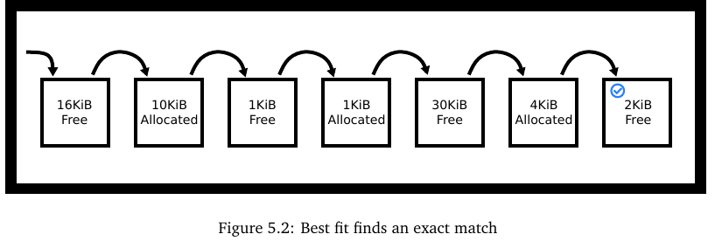
Placement Strategies
A perfect-fit strategy (best-fit) finds the smallest hole that is of sufficient size (at least 2KiB)

Slide 31
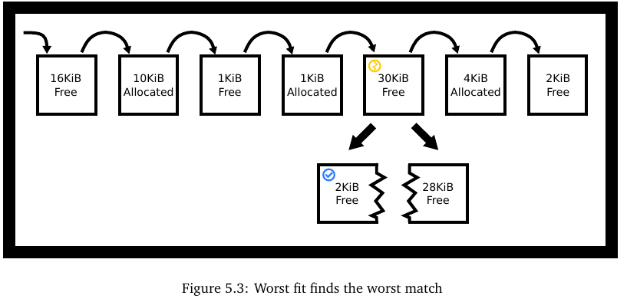
Placement Strategies
A worst-fit strategy finds the largest hole that is of sufficient size so break the 30KiB hole into two:

Slide 32
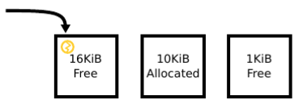
Fragmentations
internal fragmentation
Example:
First fit allocator could have returned the original 16KiB block unbroken.
User wants 2KiB
Malloc returns 16KiB
2KiB used by the user
14KiB unused by the user and the allocator.
The unused 14KiB is internal fragmentation.
Notes:
Give an example

Slide 33
Fragmentations
external fragmentation
even though we have enough memory in the heap, but not continuous!
it is divided up in a way so there is no continuous block of required memory.
Example we have 39KiB free memory, but cannot allocate 32KiB
Note: Anonymous memory mapping through mmap resolves external fragmentation.
Notes:
Give an example

Slide 34
The challenges of writing a heap allocator
Need to minimize fragmentation (i.e. maximize memory utilization)
Need high performance
Fiddly implementation – lots of pointer manipulation using linked lists and pointer arithmetic.

Slide 35
The challenges of writing a heap allocator
Both fragmentation and performance depend on the application allocation profile,
this can be evaluated but not predicted and in practice,
under-specific usage conditions, a special-purpose allocator can oftenout-perform a general-purpose implementation.
The allocator doesn’t know the program’s memory allocation requests in advance.
Even if we did, this is the Knapsack problem which is known to be NP-hard!

Slide 36
Placement Strategy Pros and Cons
Theoretical Analysis: The problem of bin packing.
Given a list A = (α₁,α₂,...α_{n},) of real numbers in the range (0, 1], place these in a minimum number of “bins” so that no bin holds numbers summing to more than 1.
let A* be the smallest number of bins into which the numbers of list may be placed.
First fit: worst case 1.7
Best fit: at least 1.7
But, a few real-world apps need this type of one-shot allocation.
https://dl.acm.org/doi/pdf/10.1145/800152.804907
M. R. Garey, R. L. Graham, and J. D. Ullman. Worst-case analysis of memory allocation algorithms. In Proceedings of the Fourth Annual ACM Symposium on Theory of Computing, STOC ’72, pages 143–150, New York, NY, USA, 1972. ACM. http://doi.acm.org/10.1145/800152

Slide 37
Placement Strategy Pros and Cons
Some practical remarks:
Best fit may take less time than a full heap scan. When a block of perfect size or of perfect size within a threshold is found, that can be returned, depending on what edge-case policy you have.
Worst fit follows this as well. Your heap could be represented with the max-heap data structure and each allocation call could simply pop the top off, reheapify, and possibly insert a split memory block.
First fit needs to have a block ordering (e.g. linked lists). with address ordered linked lists you can speed up insertion from O(n) to O(log(n)) by using a randomized skip-list in conjunction with the linked list.

Slide 38
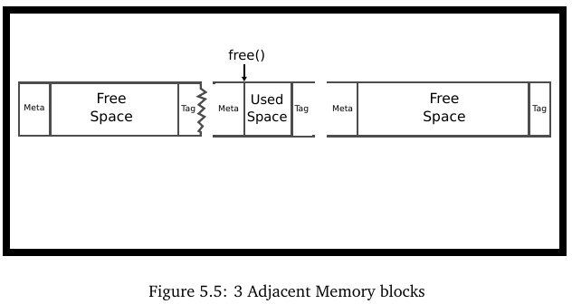
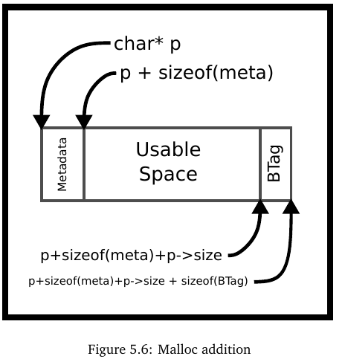
Implementing a naive-memory allocator
A memory allocator needs to keep track of which bytes are currently allocated and which are available for use.
Our heap memory is a list of blocks where each block is either allocated or unallocated.
We will create linked lists to keep track of blocks
Implicit free list: We can find the next block by finding the end of the current one
We use math to find the next block
Or we can use Explicit free list

Slide 39
Implicit free list implementation
typedef struct {
size_t block_size;
char data[];
} block;
block *p = sbrk(100);
p->block_size = 100 - sizeof(metadata) - sizeof(BTag);
/* Other block allocations*/

Slide 40
Navigation in implicit free list
/*We could navigate
from one block to the next block
by adding the block’s size.*/
p + sizeof(metadata) + p->block_size + sizeof(BTag)

Slide 41
typedef struct {
int is_free;
size_t block_size;
char data[];
} block;
block *p = sbrk(100);
p->block_size = 100
- (sizeof(metadata)
+ sizeof(btag));
The simplest implementation uses first fit.
Start at the first block, assuming it exists, and iterate until a block that represents unallocated space of sufficient size is found, or we’ve checked all the blocks.
If no suitable block is found, it’s time to call sbrk() again to sufficiently extend the size of the heap.
typedef struct {
unsigned int is_free : 1;
unsigned int block_size : 31;
} size_free;
typedef struct {
size_free info;
char data[];
} block;

Slide 42
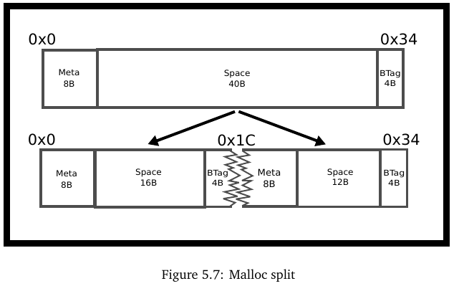
Split & alignment
Alignment: Many architectures expect multibyte primitives to be aligned to some multiple of 2 (4, 16, etc).
Address of K-byte primitive data type must be multiple K
For example, it’s common to require 4-byte types to be aligned to 4-byte boundaries and 8-byte types on 8-byte boundaries.
If multi-byte primitives are stored on an unreasonable boundary, the performance can be significantly impacted because it may require an additional memory read.
On some architectures the penalty is even greater - the program will crash with a bus error.

Slide 43
Split & alignment
/*number of 16 byte-units*/
int s = (requested_bytes + tag_overhead_bytes + 15) / 16

Slide 44
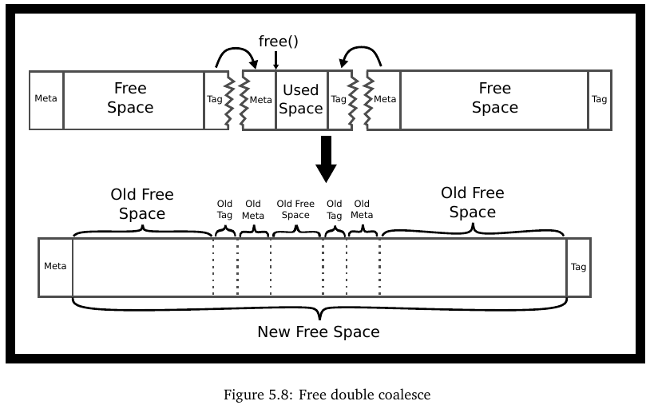
Implementing Free
We need to do more!
p->info.is_free = 0;

Slide 45
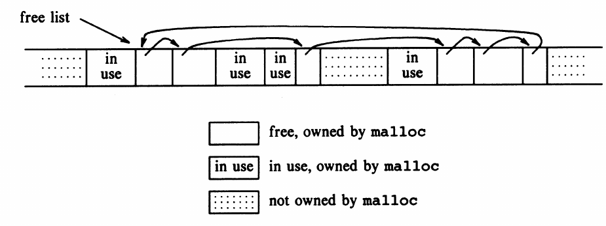
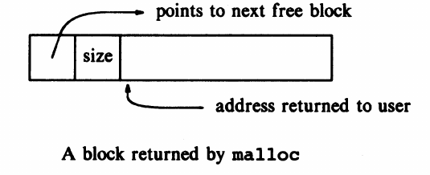
Explicit free lists allocators for better performance
List of only free blocks!

Slide 46
Where do we put newly freed block?
LIFO: insert freed block at the beginning
Simple and constant time
Studies suggest fragmentation is worse
Address-ordered policy: insert blocks so that blocks are always in address order
Requires linear time search with regular linked lists
Logarithmic time with the use of balanced trees
Studies suggest ft fragmentation is better
struct {
size_t info;/*number of 16 byte blocks*/
struct block *next;
char data[];
}block;

Slide 47
Coalescing in explicit free lists
Neighboring free blocks are already part of the free list
Remove old block
Add new coalesced block
How do we tell neighboring blocks are free?
Use boundary tags

Slide 48
Segregated Lists
Segregated Lists
Keep separate lists of blocks for different sizes:
E.g.: list of 8s, list 16s, list of 32s, list of 64 …
Suballocators for each free list
Buddy Allocator
Block size: 2^{n}, n=1,2,3...
If there are no free blocks of 2^{n}, go to the next level and steal that block and split into two
If two neighboring blocks of the same size free, coalesce into large block of twice the size
Main disadvantage: internal fragmentation
68-byte requires 128-byte block
Slab allocator: fixed sizes for special data structures

Slide 49
Summary of keeping track of free blocks
Implicit list: using sizes to determine next block
Explicit list: linked list amont free blocks by using pointers
Segregated list: different free list for different sizes
You can also sort blocks by size
Use balanced tree, length is used as the key

Slide 50
sbrk() vs mmap()
mmap()
Allocate some resource into the process’s memory space (memory mapped files)
Process’s address space is composed of different memory areas
Easy to allocate and deallocate(hand back to OS)
POSIX standard, used in malloc() for large blocks
sbrk()&brk()
No longer part of POSIX,
used in malloc for small memory allocations
Easy to extend the heap memory
Not easy to hand back the allocated memory to OS

